Slide 1
FUZZY LOGIC
Deepika Dash
10 March 2016

Slide 2
What does fuzzy means
Fuzzy logic means its a logic which isn’t very precise
Fuzzy logic can be defined as a superset of conventional (Boolean) logic that has been extended to handle the concept of partial truth - truth values between “completely true” and “completely false”

Slide 3
Types of Uncertainty and the Modeling of Uncertainty
Stochastic Uncertainty
Here the probability of hitting the target is 0.8
Lexical Uncertainty
"Tall Men", "Hot Days", or "Stable Currencies"
We Will Probably Have a Successful Business Year
Not True.
The Experience of Expert A Shows That B Is Likely to Occur. However, Expert C Is Convinced This Is Not True.

Slide 4
Probability and Uncertainty
“... a person suffering from hepatitis shows in 60% of all cases a strong fever, in 45% of all cases yellowish colored skin, and in 30% of all cases suffers from nausea ...”
STOCHASTICS AND FUZZY LOGIC COMPLEMENT EACH OTHER !

Slide 5
Fuzzy Set Theory
What is Fuzzy set .
How it is different from conventional set theory
Concept of Fuzzy no
Zero
Almost Zero
Near Zero

Slide 6
INTRODUCTION
What is Fuzzy Logic?
Problem-solving control system methodology
Linguistic or "fuzzy" variables
Example:
IF (process is too hot)
AND (process is heating rapidly)
THEN (cool the process quickly)

Slide 7
Advantages & Disadvantages
ADVANTAGES
Mimicks human control logic
Uses imprecise language
Inherently robust
Fails safely
Uses imprecise language
Disadvantages
Operator's experience required
System complexity
Inherently robust
Fails safely
Modified and tweaked easily
Advantages
Mimic human control logic
Uses imprecise language
Inherently robust
Fails safely
Modified and tweaked easily

Slide 8
APPLICATION
Simple Proportional Temperature Controller
Components
An electric heating element
Variable-speed cooling fan
Functionality
Positive signal output: 0-100% heat
Negative signal output: 0-100% cooling

Slide 9
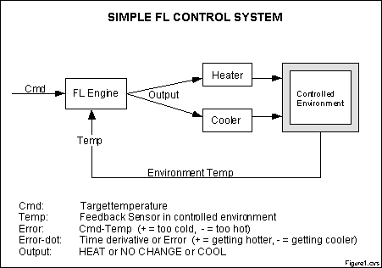
SIMPLE CONTROL SYSTEM

Slide 10
APPROACH
Usage
Define the control objectives and criteria
What am I trying to control?
What do I have to do to control the system?
What kind of response do I need?
What are the possible (probable) system failure modes?
Determine the input and output relationships
Choose a minimum number of variables for input to the FL engine
Use the rule-based structure of FL
Break the control problem down into a series of rules
Create FL membership functions
Define the meaning (values) of Input/Output terms used in the rules
Test, evaluate, tune and retest

Slide 11
APPLICATION(cond.) (Cont
Define the control objectives and criteria
What am I trying to control?
System temperature
What do I have to do to control the system?
Proper balance and control of the functional devices
What kind of response do I need?
Stable Environment temperature
What are the possible (probable) system failure modes?
The lack of the “No change” region

Slide 12
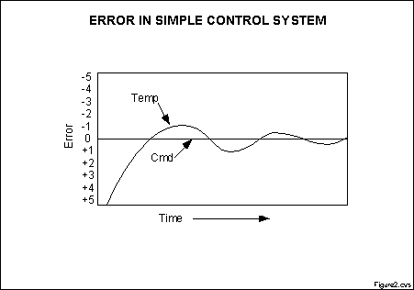
APPLICATION (Contd.)
What is being controlled and how?

Slide 13
FUZZY LOGIC IN CONTROL SYSTEMS
Fuzzy Logic provides a more efficient and resourceful way to solve Control Systems.
Some Examples
Temperature Controller
Anti – Lock Break System ( ABS )

Slide 14
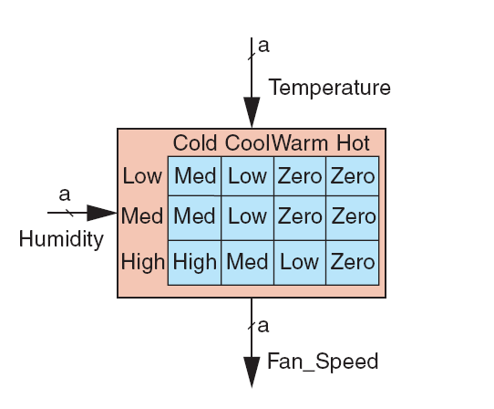
TEMPERATURE CONTROLLER
The problem
Change the speed of a heater fan, based off the room temperature and humidity.
A temperature control system has four settings
Cold, Cool, Warm, and Hot
Humidity can be defined by:
Low, Medium, and High
Using this we can define the fuzzy set.

Slide 15
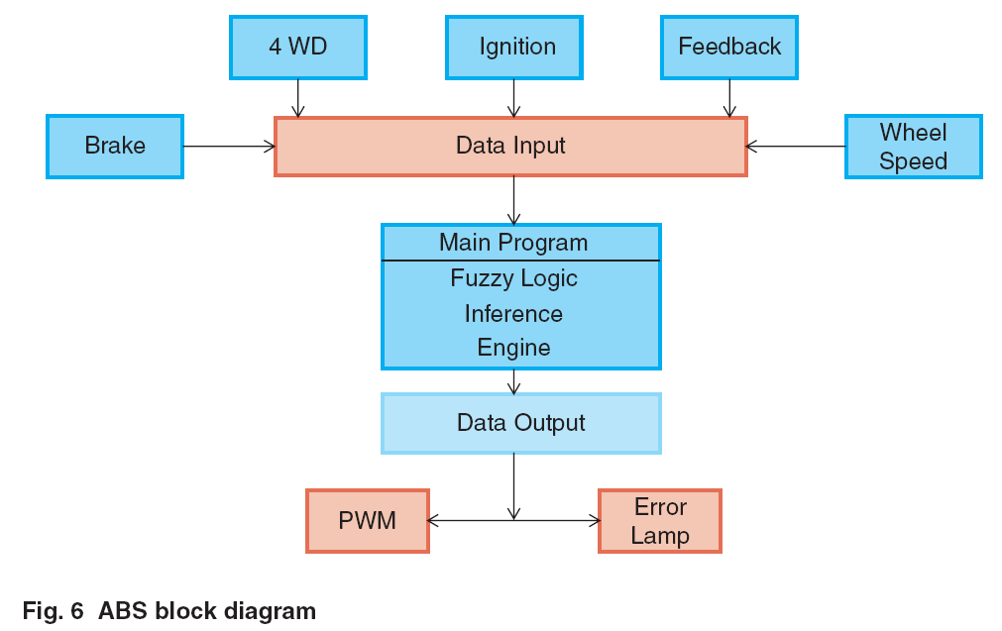
ANTI LOCK BREAK SYSTEM ( ABS )
Nonlinear and dynamic in nature
Inputs for Intel Fuzzy ABS are derived from
Brake
4 WD
Feedback
Wheel
Outputs
speed
IgnitionPulsewidth
Error lamp

Slide 16
CONCLUSION
Fuzzy logic provides an alternative way to represent linguistic and subjective attributes of the real world in comptinug
It is able to be applied to control systems and other applications in order to improve the efficiency and simplicity of the design process

